Slide 1
Python Bootcamp
Session 2 : Python Basics

Slide 2
Python Data Types and Methods
Python has 5 main Data Types:
  Strings
  Numericals : Integers and Floats
  Tuples
  Lists
  Dictionaries
A method is a programmed function that “belongs to” an object or data type. This function, when called, is applied directly to the element it is used with
A variable is a symbolic name that is a reference to an object. If we write: x = 5 then x is a variable and for now it holds the value 5

Slide 3
Printing and Basic String Operators
The print function is arguably the most important function in Python as it allows you to inspect all variables and visualize results
It can be used with all data types
A string can be seen as an array of characters. In Python, all arrays start with an index of 0. So if we have the string “Hello” character number 0 would be “H” and character number 4 would be “o”
Strings can be combined with other strings to create bigger strings. This is called concatenation
Python data types can be turned into strings by using the “str” function

Slide 4
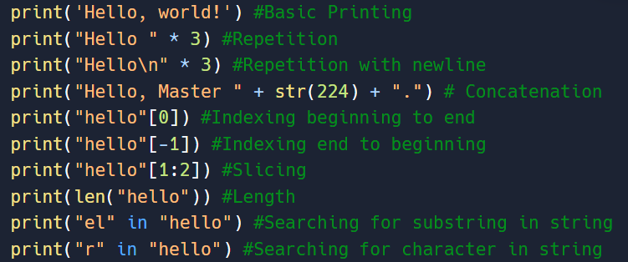
What will these lines of code print out ?
Notes:
print('Hello, world!') #Basic Printing
print("Hello " * 3) #Repetition
print("Hello\n" * 3) #Repetition with newline
print("Hello, Master " + str(224) + ".") # Concatenation
print("hello"[0]) #Indexing beginning to end
print("hello"[-1]) #Indexing end to beginning
print("hello"[1:2]) #Slicing
print(len("hello")) #Length
print("el" in "hello") #Searching for substring in string
print("r" in "hello") #Searching for character in string

Slide 5
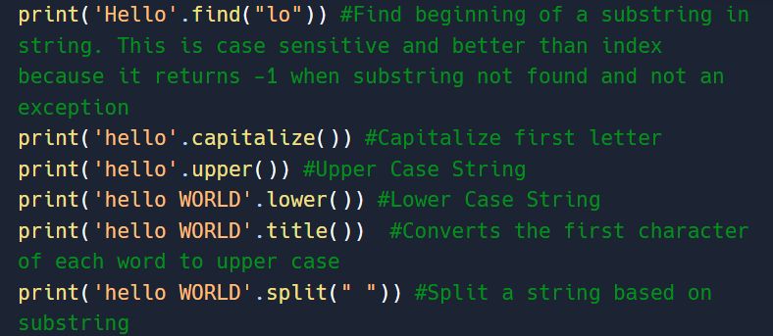
String Methods
A list of all string methods can be found here : Python String Methods
Here are the most common ones:
Notes:
print('Hello'.find("lo")) #Find beginning of a substring in string. This is case sensitive and better than index because it returns -1 when substring not found and not an exception
print('hello'.capitalize()) #Capitalize first letter
print('hello'.upper()) #Upper Case String
print('hello WORLD'.lower()) #Lower Case String
print('hello WORLD'.title()) #Converts the first character of each word to upper case
print('hello WORLD'.split(" ")) #Split a string based on substring

Slide 6
Floats, Integers and Operators
An int or integer is a whole number, positive or negative, without decimals.
Floats are numbers, positive or negative, with a value after the decimal point
Floats and integers are the only data types in Python with no methods associated with them
You can use arithmetic operations between these 2 types with no issue

Slide 7
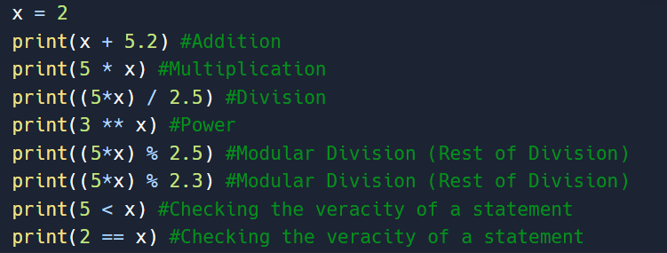
What will these lines of code print out ?
Notes:
x = 2
print(x + 5.2) #Addition
print(5 * x) #Multiplication
print((5*x) / 2.5) #Division
print(3 ** x) #Power
print((5*x) % 2.5) #Modular Division (Rest of Division)
print((5*x) % 2.3) #Modular Division (Rest of Division)
print(5 < x) #Checking the veracity of a statement
print(2 == x) #Checking the veracity of a statement

Slide 8
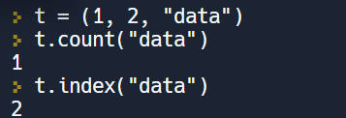
Tuples, Methods and Operators
A tuple is a simple collection of arbitrary objects
A tuple is unchangeable after its creation and accepts duplicates
Tuples are created and printed out with normal brackets “( )”
The downside of tuples is that they have only 2 methods. Python Tuple Methods

Slide 9
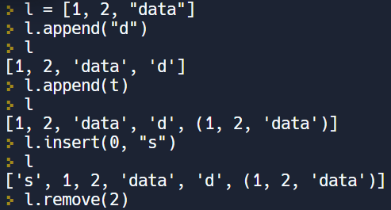
Lists, Methods and Operators
A list is a simple collection of arbitrary objects
A list is changeable after creation and accepts duplicates
Lists are created and printed out with square brackets “[ ]”
The upside of lists is that they have many methods. Python List/Array Methods

Slide 10
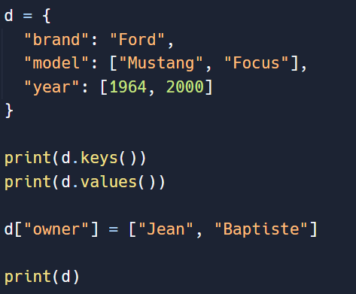
Dictionaries, Methods and Operators
A dictionary is used to store data values in key:value pairs
A dictionary is changeable, but it does not allow duplicate keys
Dictionaries are created and printed out with curly brackets “{ }”
Dictionaries, like lists, have many methods: Python Dictionary Methods
Notes:
d = {
"brand": "Ford",
"model": ["Mustang", "Focus"],
"year": [1964, 2000]
}
print(d.keys())
print(d.values())
d["owner"] = ["Jean", "Baptiste"]
print(d)

